Slide 1
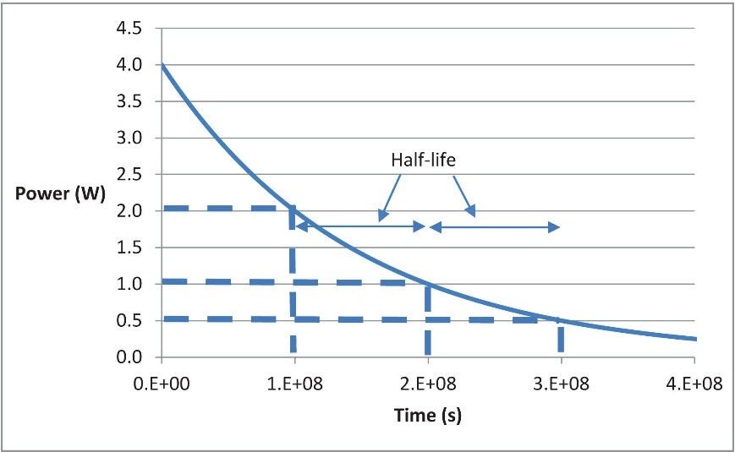
FIGURE 11.1 Radioactive Decay

